Slide 1

Smart Mobility: Traffic & Parking Management
The Architecture of Our Solution
Made by
Marvin Beste
Viktor Reiswich
Petra Czettisch
Leander Lohaus

Slide 2

Architecture

Slide 3
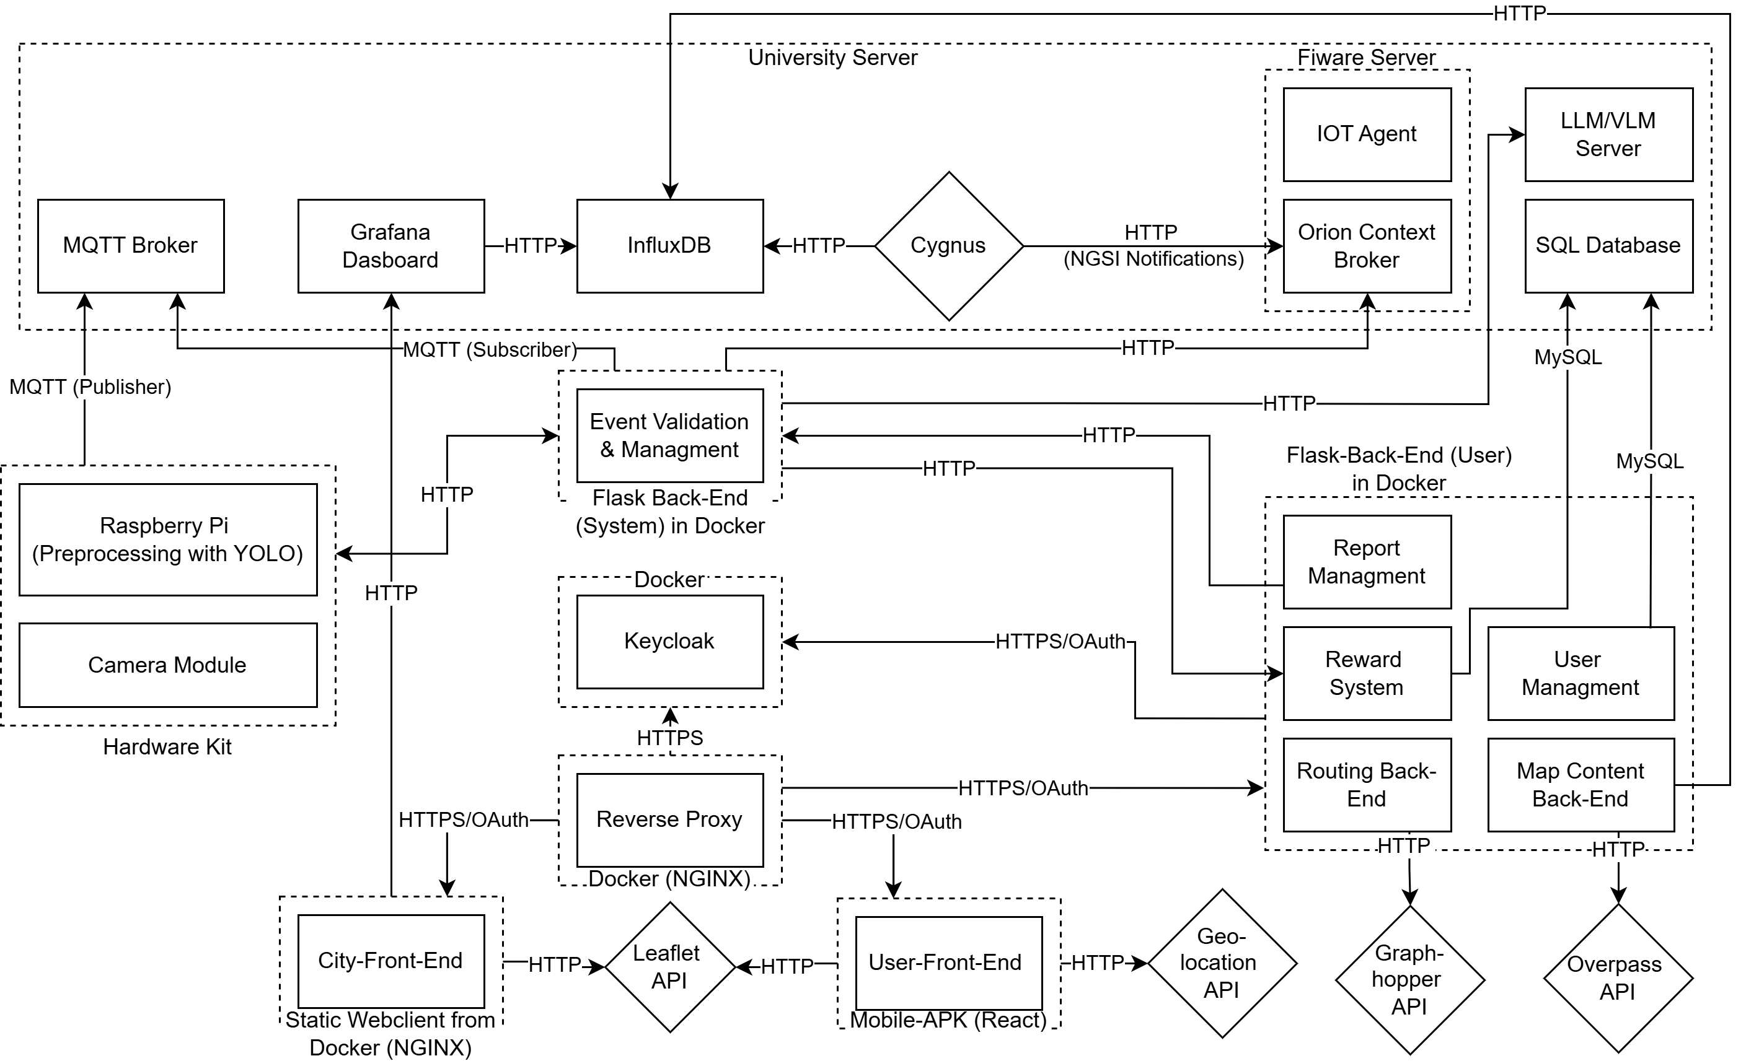

Slide 4
CAMERA PIPELINE OVERVIEW
Camera Detection
Local Processing
Snippet
MQTT/HTTP
Hardware & Edge Processing
Raspberry Pi + Camera module
YOLOv8 Nano/Tiny
MobileNetSSD as backup
Detects: vehicle presence, parking gaps, double parking suspicion, red-light suspicion
Creates snippets with metadata

Slide 5
CAMERA PIPELINE OVERVIEW
MQTT/HTTP
Vision AI
Fiware
Communication Layer
MQTT sends event metadata as lightweight JSON
HTTP Upload API sends image snippets
AI Validation & Decision Making
Confirms double parking
Uses virtual stop-lines to confirm red-light violations
Detects parking spot availability by measuring curb distances
Data Storage & Management (FIWARE)
Orion Context Broker for context management
InfluxDB for time-series event storage

Slide 6
Detection approaches
Double Parking
Vehicle detected in driving lane, not in a valid parking zone
Remains stationary for a set duration
Works with Bounding boxes & marked areas
Roadside Parking Space
Vehicles near the curb are detected
Distance between vehicles is measured
If gap > threshold (e.g., 5.5 meters) → spot classified as available

Slide 7
Detection approaches
Red-Light Violation
Virtual stop-line set using manual mapping
Traffic signal status via camera detection
If vehicle crosses stop-line during red phase → violation suspected
Traffic Congestion Detection
Vehicle density estimated using YOLO
Count vehicles

Slide 8
Map Visualization
3D supported
MapLibre Pros
Leaflet Pros
Smallest file size
Already used
Easy to learn and implement
Extensive library of plugins
Vector and raster tiles
Smooth zooming
Visualization Technology (Leaflet):
Accidents & Violations: Leaflet markercluster
Traffic & Parking: Leaflet polylines (via GeoJSON)
Leaflet Layer Control: toggling map layers with dynamic legend
Overpass API: for road network integration

Slide 9
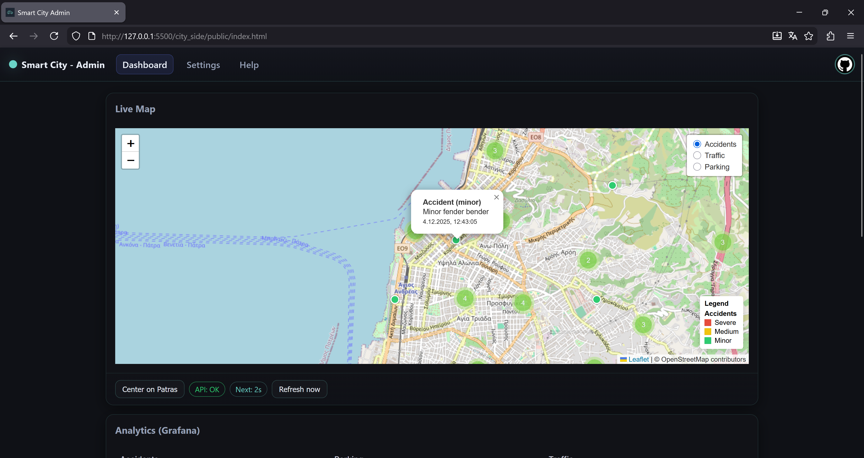

Slide 10
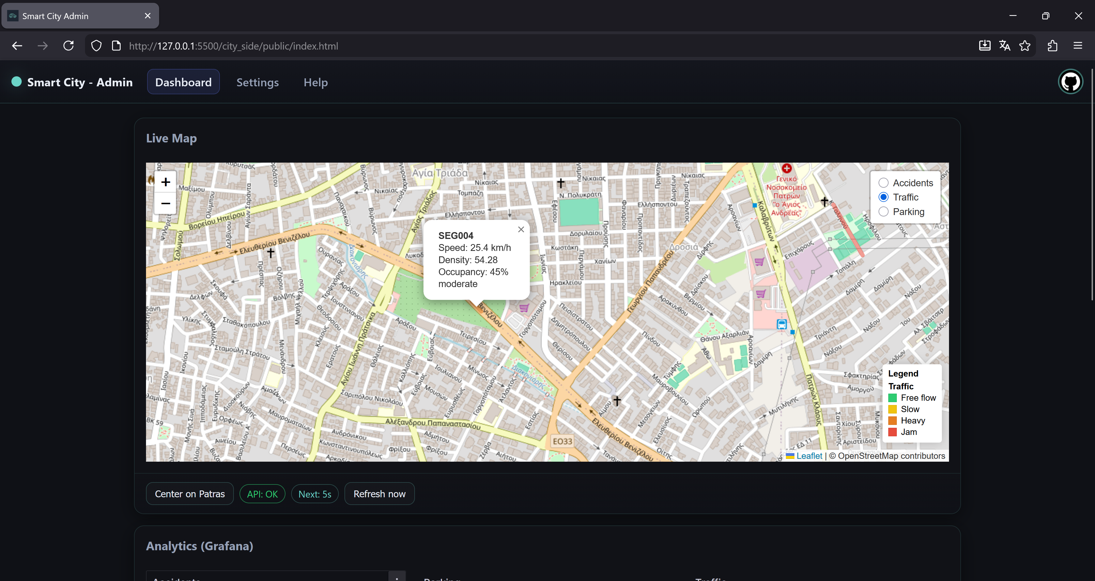

Slide 11
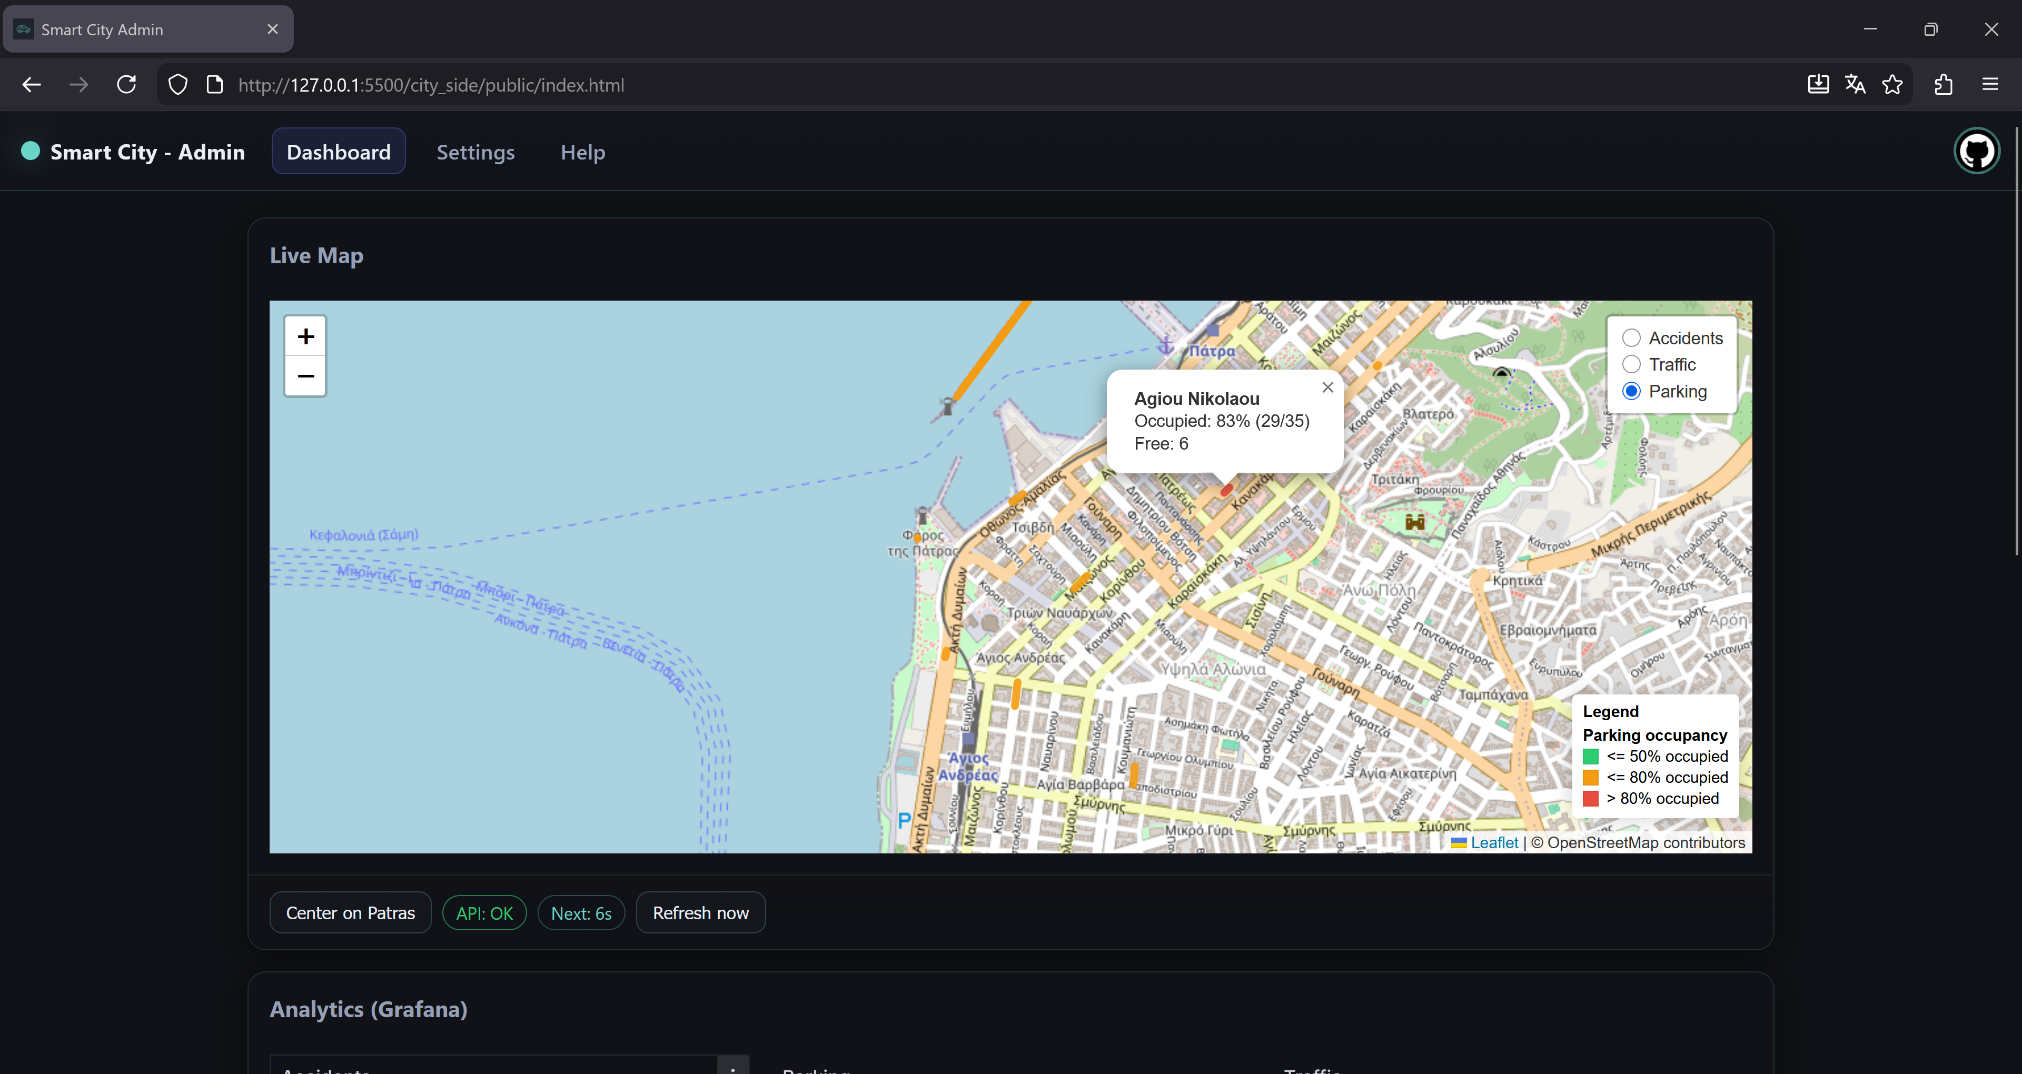

Slide 12
City Dashboard: Analytics
Context Broker
Cygnus
InfluxDB
Grafana/ LLM
Overview:
Grafana dashboard for city analysis
Shows Parking occupation, Traffic violations
Connected to InfluxDB via Cygnus
Updated live from Orion Context Broker
Filters:
Time period: define custom range
Location: selected district or visible map area
AI Suggestions:
Gathered Data analysed by University LLM
Generates traffic improvement recommendations

Slide 13
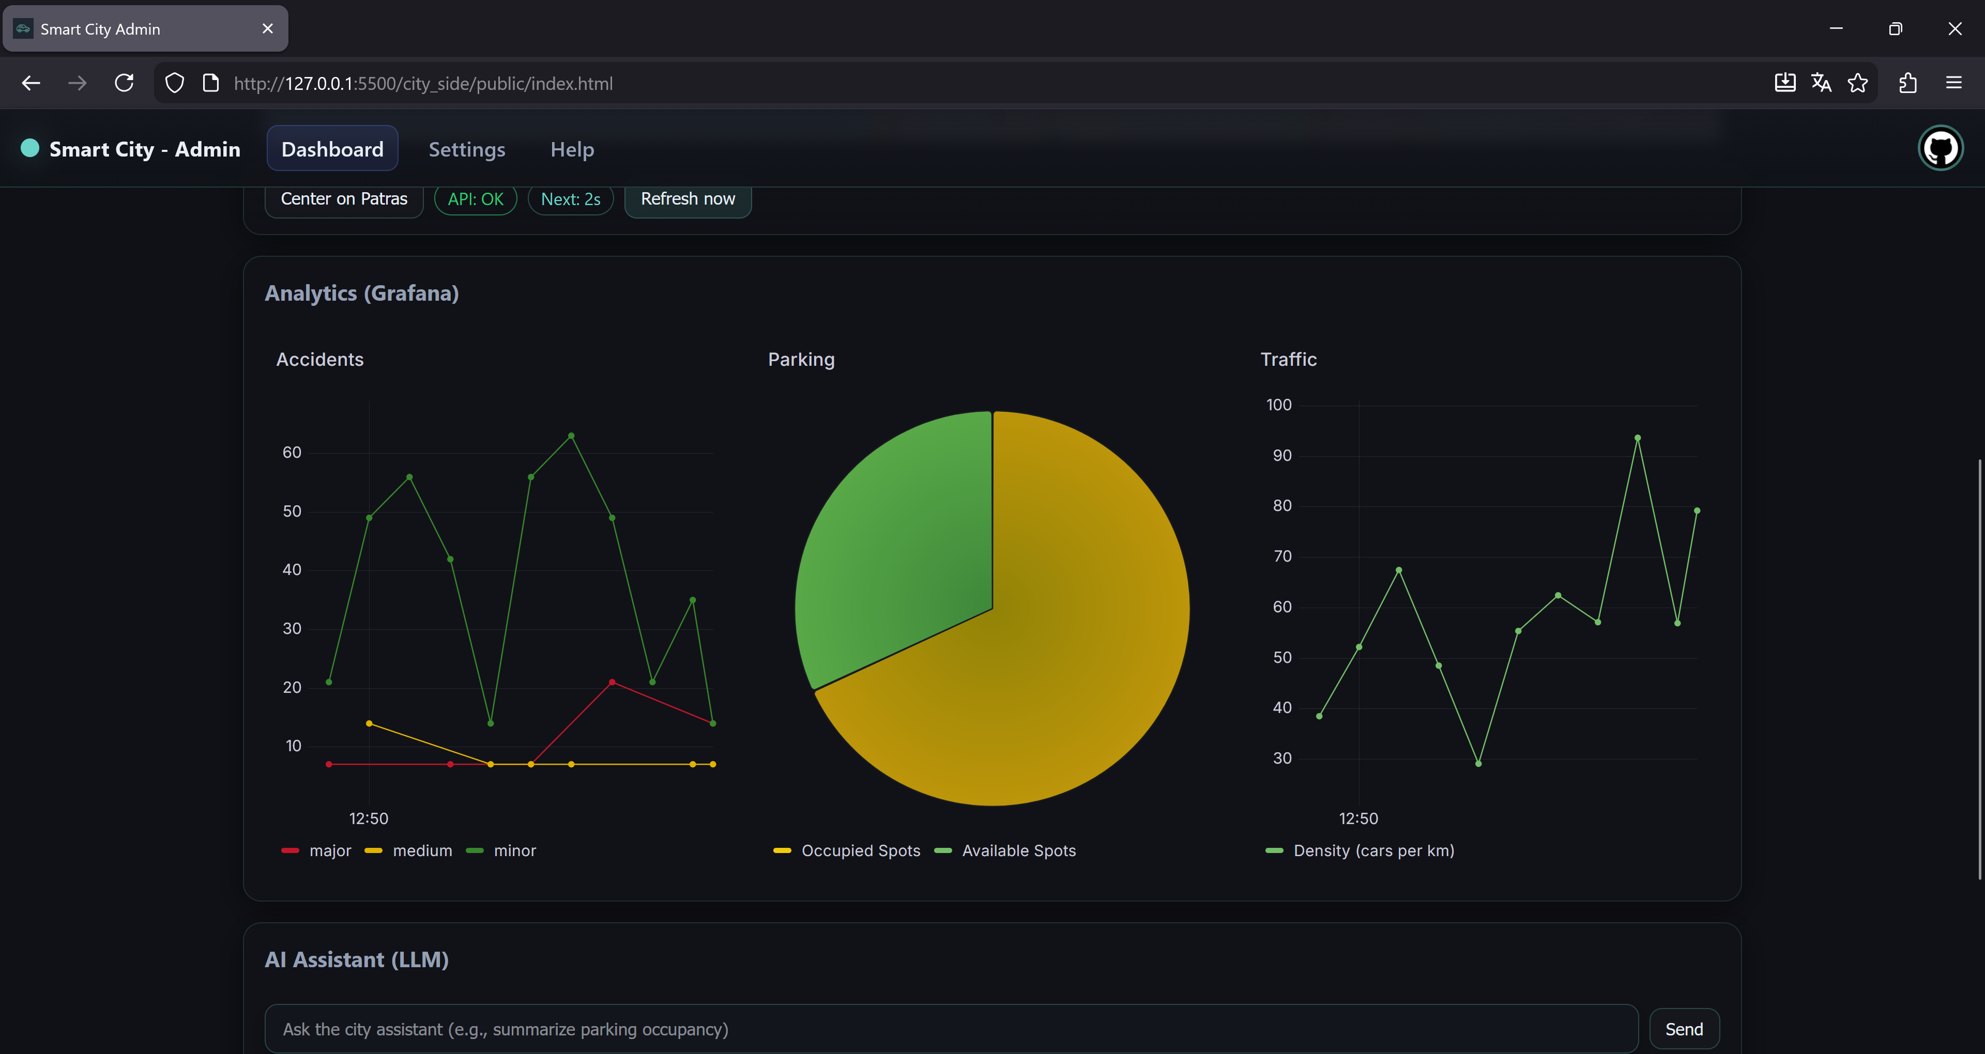

Slide 14
Driver Routing:
Backend
With Graphhopper API
DS-Frontend
DS-Frontend
With Geolocation API
Driver-Side Frontend (React + Leaflet):
Uses Geolocation API to get current position
Backend:
Finds the nearest available parking spot
Requests a route from the Graphhopper API
Driver-Side Frontend:
Renders the route on the map via Leaflet

Slide 15
Reporting system
User Front-End
Incoming Requests
Data Storage
Validation
User Interface:
Progressive Web App
Category selection
Automatic geolocation & Timestamp
Incoming Requests:
User Back-End
Receives data via HTTP POST
Storage & Persistence:
Primary storage in InfluxDB Database
Via Event Validation service to the Orion Context Brocker
Validation Logic:
Sensor Check

Slide 16
Reward System
Violation Detection
Back-End
VLM Server
Context Broker
Two streaks per user: Parking, Traffic
License plate registration optional (required for points)
Daily increment if no violation
Reset on violation event
Milestones trigger point rewards
Milestones:
For each week: 100 points
For each month: extra 500 points
For each year: extra 100 points

Slide 17
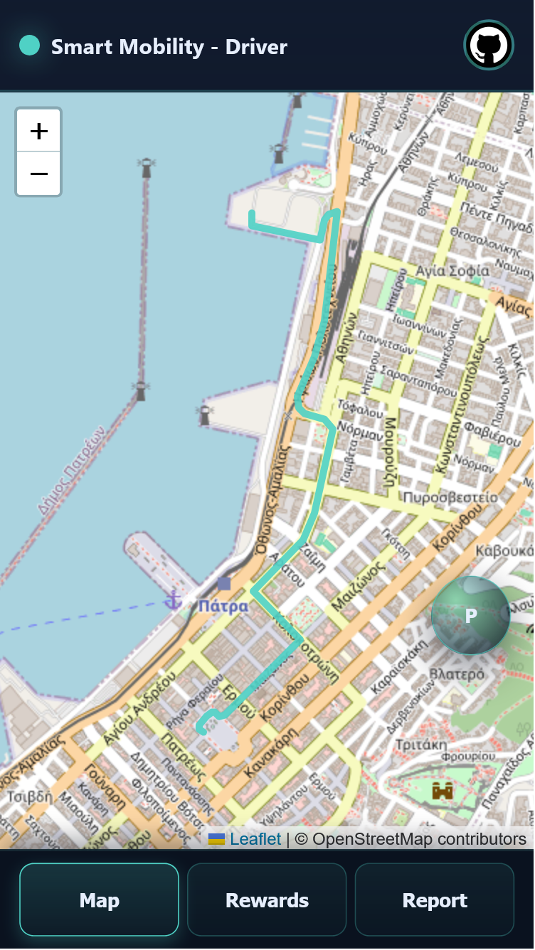
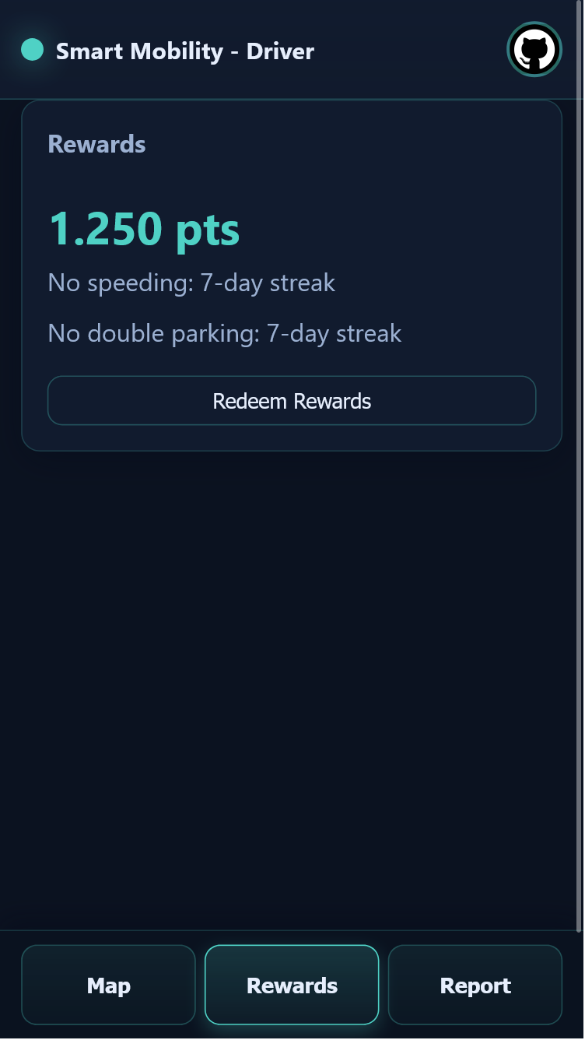
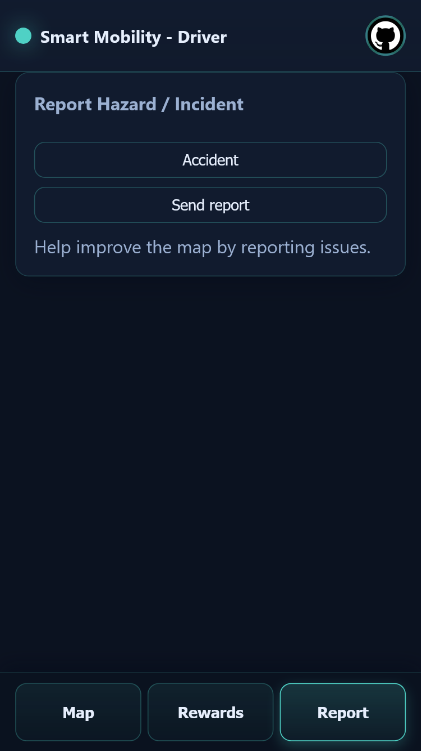

Slide 19
Timeline
0. Phase (Before 05.11.25)
Fiware Communication Module
Cygnus Integration
YOLO Environment Setup
2. Phase (12.12.25.-18.12.25)
Full Data Faker Imp-lemenation
Leaflet & Graphhopper Integration
YOLO preprocessing Pipeline
3. Phase (19.12.25-02.01.26)
Working YOLO Integration
User Management
Grafana Dashboard With Filters
4. Phase (03.01.26.-09.01.26)
Improvement of leaflet and Graphhopper integrations
Working AI Suggestions
5. Phase (10.01.26-15.01.26)
Reward & Report System
Small Refinements
6. Phase (16.01.26-18.01.26)
Testing & Debugging
Final Version of Solution & Presentation
1. Phase (05.11.25-11.12.25)
City-Frontend (Map, Grafana)
User-Frontend (React) with Map
Backend (Fiware, InfluxDB & Data Fakers)

